Slide 1
ANALYSIS OF USER BEHAVIOUR TRACKING AND DETECTION & ELIMINATION OF HACKER IN CLOUD ENVIRONMENT
Project Members
Devi N | 412919104003
Logesh E | 412919104006
Guided by
CSE
Department of Computer Science & Engineering

Slide 2


INTRODUCTION
Shopping Attackers Threats Are the most Drawback in the Startup Shopping Websites. Threats in the Carding is evolved A lot . Now a days , Illegal Carding is advanced to Account & Card details Hacking to Overcome this Disadvantages in the Startup Websites Our project is Introduced

Slide 3
ABSTRACT
Users Behavior is analyzed based on previous behavior such as Posted Data, Time of posting, IP Address & Location of usage of Social Media. Our implementation we include two processes.
1. As per the Paper Compromised Social networks Accounts are tracked & detected.
2. If hacker attacks the Genuine user then our allows the attacker to proceed further until our system captures all the important information about the attacker.
We generate Honey words, the users original password is converted into another format and stored along with the Honey words. Attacker logins into the purchase portal, where he is been tracked unknowingly & he is allowed to do purchase. Server identifies the attacker and sends the info to the Original owner and also it blocks the attacker even doing transaction from his original account. The main aim of the project is detect the attacker in shopping purchase portal. Identify the hacker and send those hacker details into original user.

Slide 4
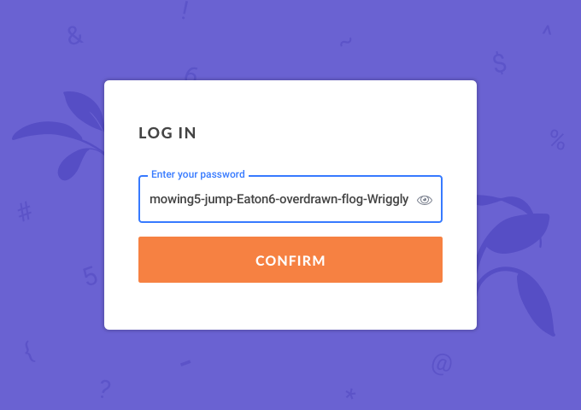

EXISTING SYSTEM
Guessing of Long Passwords Is the Method Which Will Convert And the Short Original Password To Long Fake Password With Effective Grammar And Store it in a User Details Database .If the Hacker Bleach the Firewall ,He cant get the Exact password . But There are some Disadvantages in that

Slide 5


DISADVANTAGES OF EXISTING SYSTEM
Security is very low, so that the attacker can easily hack the passwords of the users and can do anything.
Passwords can be hacked using guessing attacks

Slide 6

PROPOSED SYSTEM
This concept comes from a special kind of encryption scheme called Honey encryption, Honey encryption involves senders and receivers creating convincing fake evidence of forged data in cipher texts such that outside coercers are satisfied.

Slide 7


ADVANTAGES OF PROPOSED SYSTEM
The attackers are not able to guess and hack the passwords.
It provide high security to data owner
Hacker IP address and address sent to original user via email

Slide 8
ALGORITHM / METHODOLOGY
HONEY WORD GENERATION
Honey words (decoy passwords) have been proposed to detect attacks against hashed password databases.
For each user account, the original password is stored with many honeywords in order to thwart any adversary.
The honeywords are selected deliberately such that a cyber-attacker who steals a file of hashed passwords cannot be sure, if it is the real password or a honeyword for any account.
Moreover, entering with a honeyword to login will trigger an alarm notifying the administrator about a password file breach

Slide 9
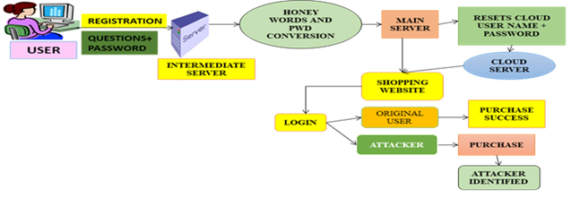
ARCHITECTURE DIAGRAM

Slide 10
DATA FLOW DIAGRAM
LEVEL 0
INTERMEDIATE SERVER
REGISTER THE QUESTIONS & PASSWORD
USER
LEVEL 1
HONEY WORD & PASSWORD CONVERTION
CLOUD SERVER
USER
PASSWORD

Slide 11
LEVEL 2
SHOPPING WEBSITE
USER
LOGIN
AUTHORIZED USER
PURCHASE SUCCESS

Slide 12
LEVEL 3
SHOPPING WEBSITE
UNAUTHORIZED USER
IDENTY THE ATTACKER
SENT IP ADDRESS TO MAIL ID

Slide 13


HARDWARE & SOFTWARE REQUIREMENTS
SOFTWARE REQUIREMENTS
HARDWARE REQUIREMENTS
Windows Xp/7/8/10/11
Node JS
React JS
Mongo DB
Drop Box
HDD: 1 TB
RAM: 8 GB
Processor: Ryzen 5 4600H
NVidia GPU 4GB

Slide 14

MODULES
User Registration
Server
Honey words Generation
Intermediate Server & Shopping Server Deployment
Password Hacking Process
Identification of Attackers & Remove DDOs Attacks

Slide 15

USER REGISTRATION
In this module bank user details are registered with the fields like username, password, and personal details with some set of questions and answers. These details are saved into the server. After proper registration only the user can allowed to login into the server.

Slide 16
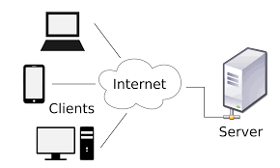
SERVER
In this Server module server will deployed to access the database and web based application. Server will verify the users and generates honey word for save the users password. In case illegal actions happened means server will generates alert and intimate it to user.

Slide 17
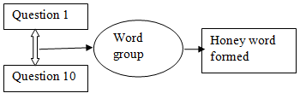
Honey words Generation
In this module we deployed honey word creations. That is the user’s password and registered questions are combined and then it will generates a key as unknown Name.

Slide 18

Intermediate Server & Shopping Server Deployment
Here we will generate the Intermediate server to make communication between user and Server. All requests comes from the users are first sent to the intermediate server to verifies the password and user details. Shopping server is to collect the details from customer and sent to the details to the intermediate server for verification

Slide 19

Password Hacking Process
Password Hacking is blocked in this Module. Because we modifies the users original passwords into unknown Name and saved into server.

Slide 20
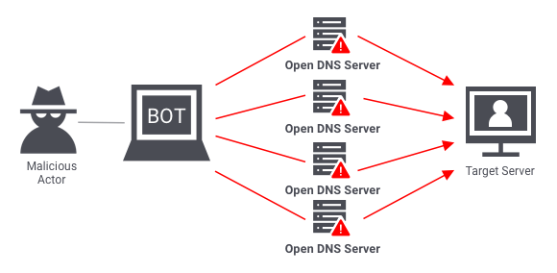
Identification of Attackers & Remove DDOs Attacks
If there is anybody trying with wrong password or any illegal action means server will block that action and intimate to the Specified Users. If the same request comes from same user or from different user’s means server will blocks that actions also. This is done in DDOS attack.

Slide 21
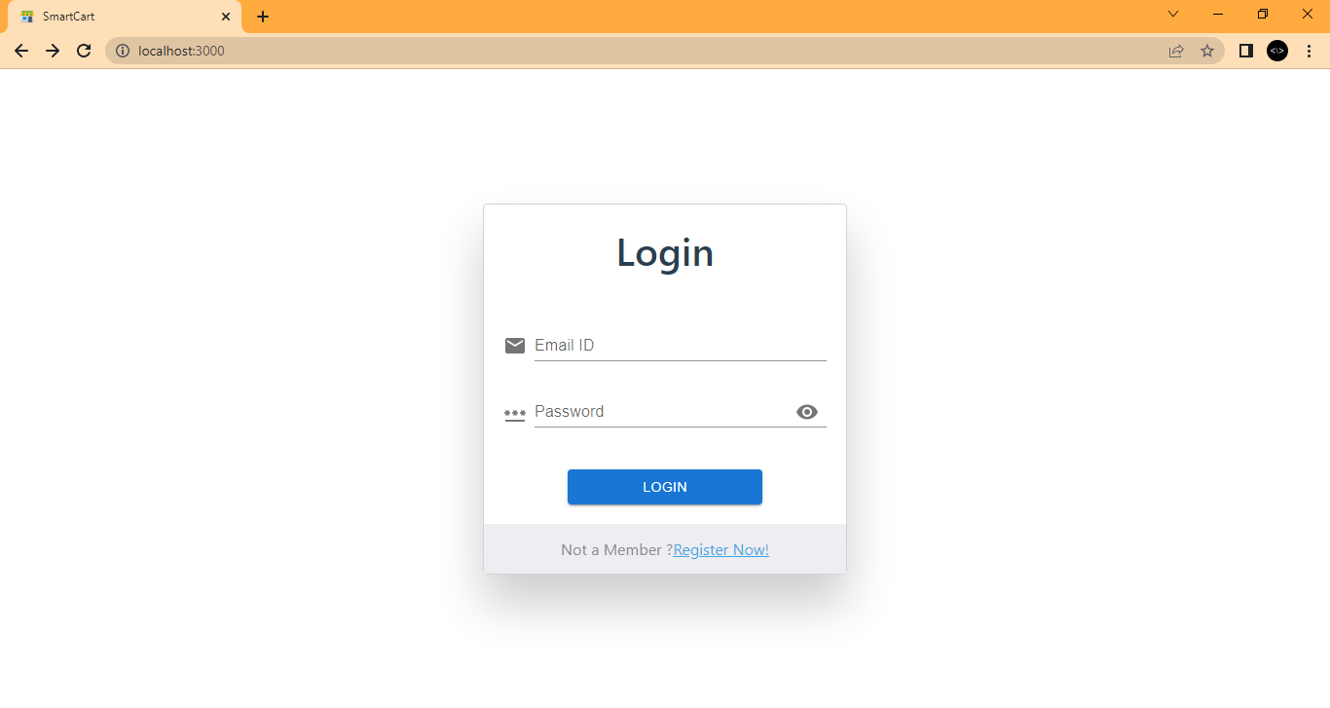
OUTPUT SCREENSHOT

Slide 22
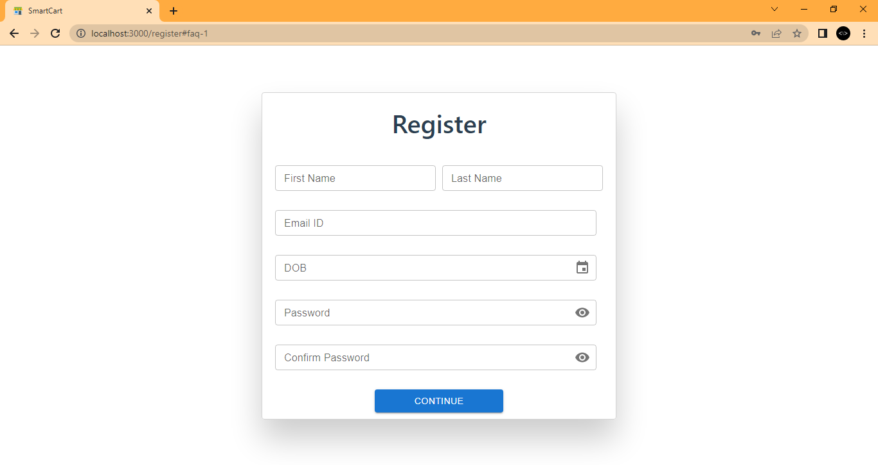

Slide 23
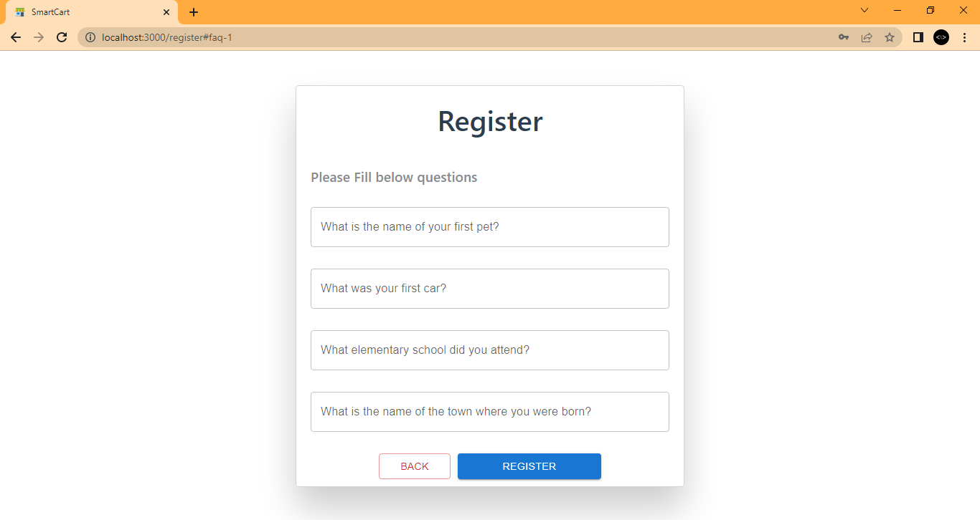

Slide 24
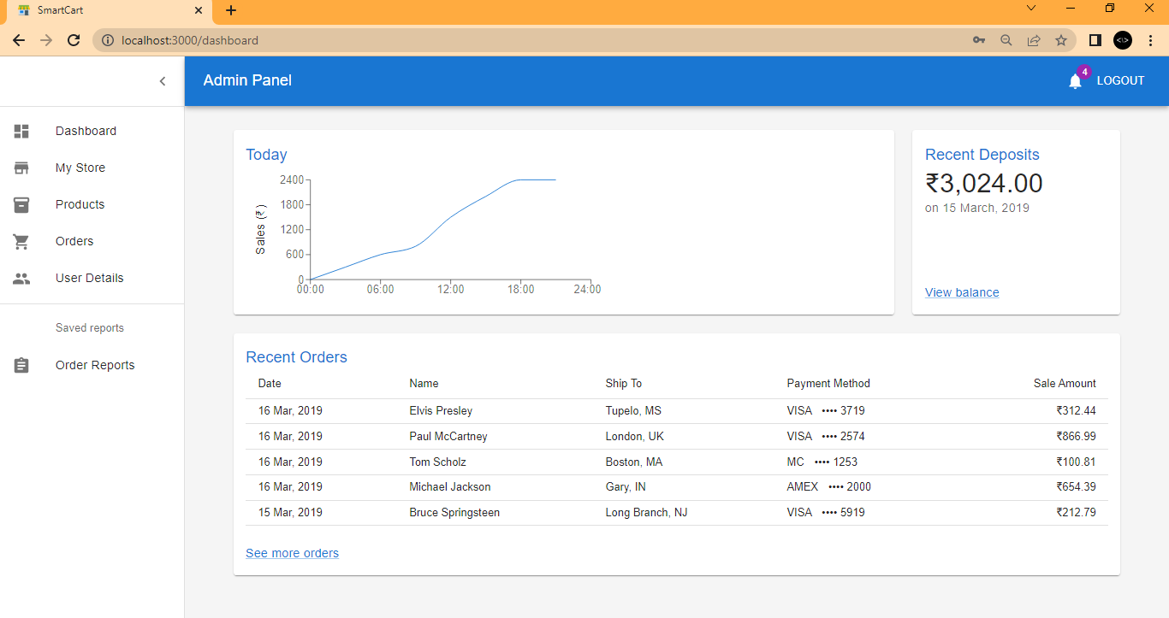

Slide 25
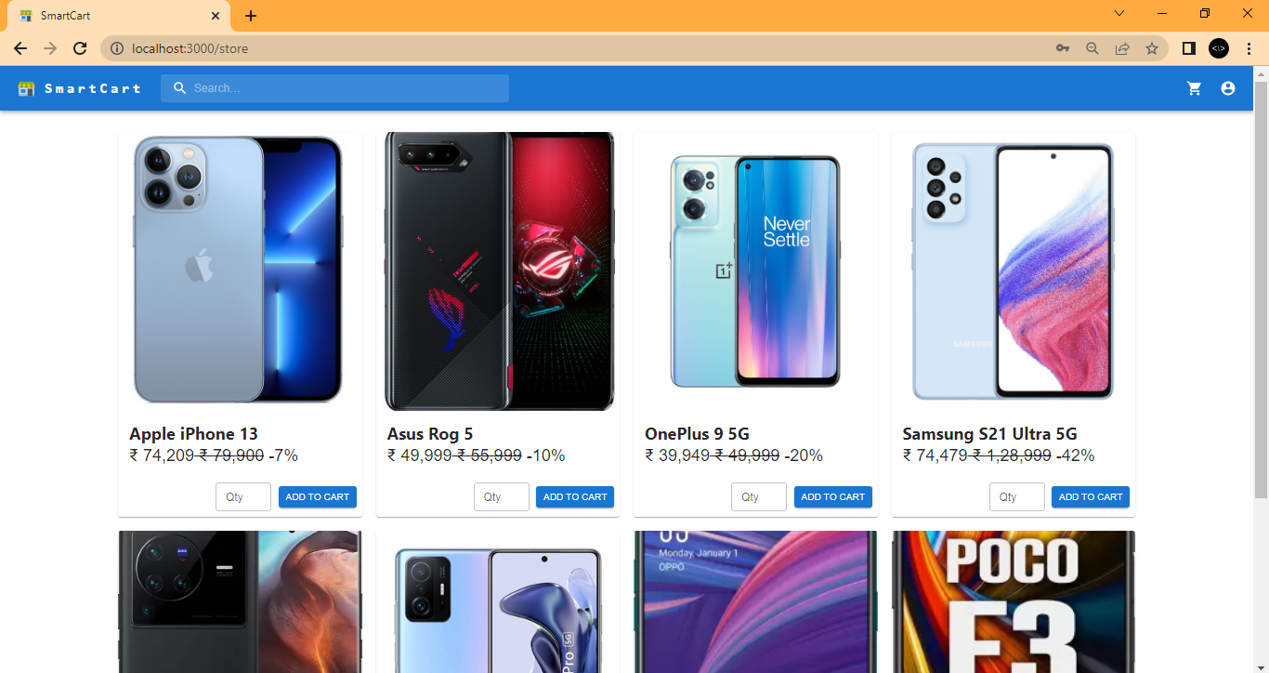

Slide 26
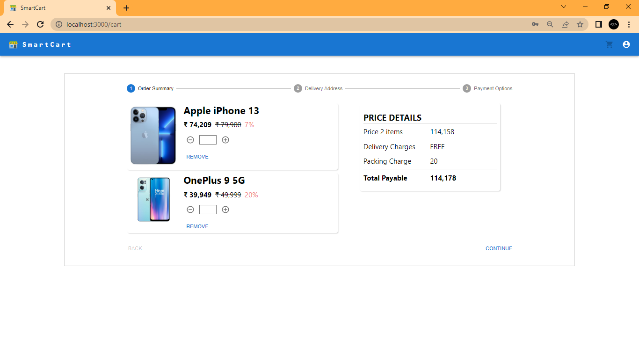

Slide 27
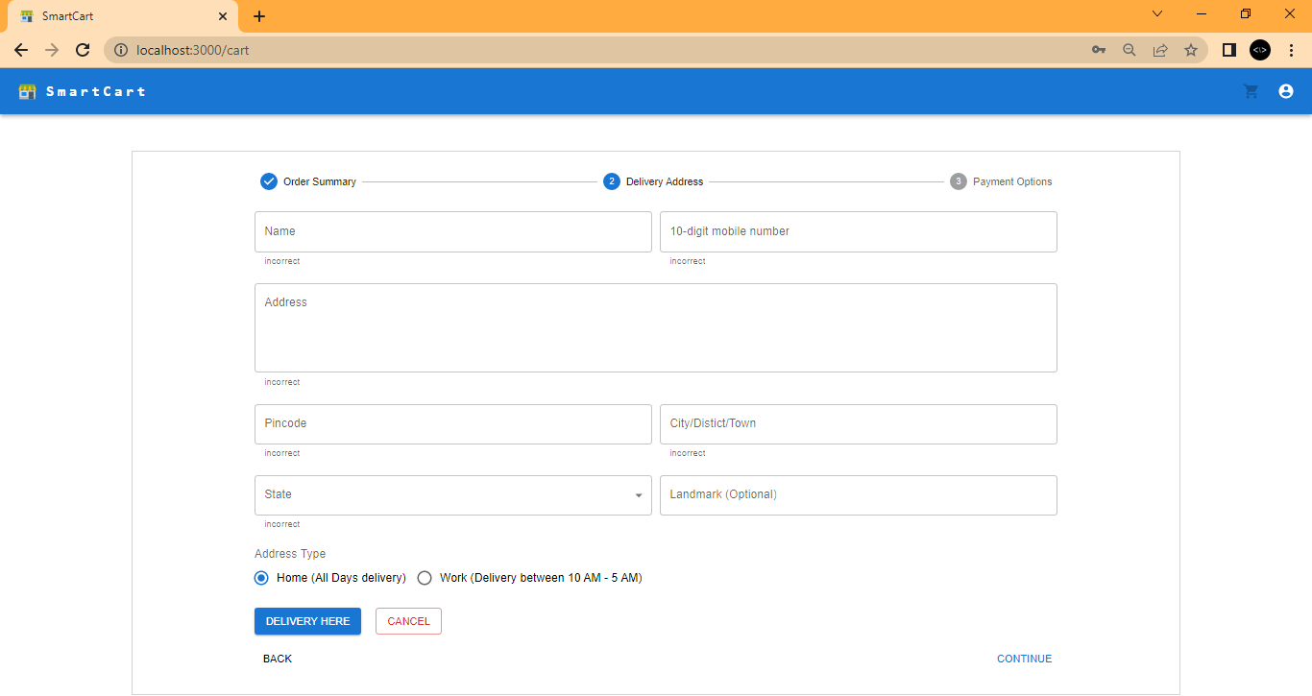

Slide 28
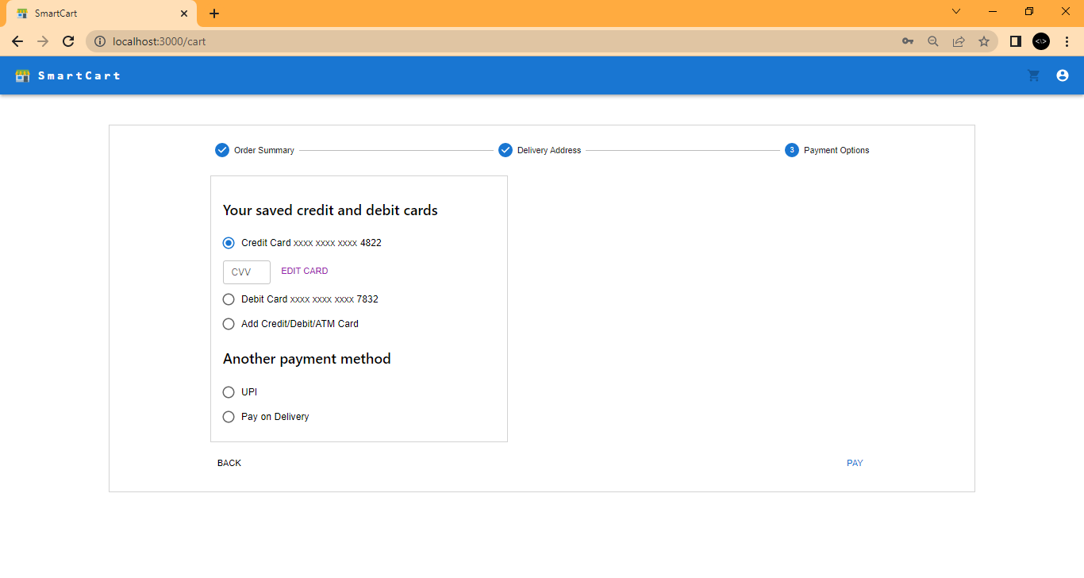

Slide 29
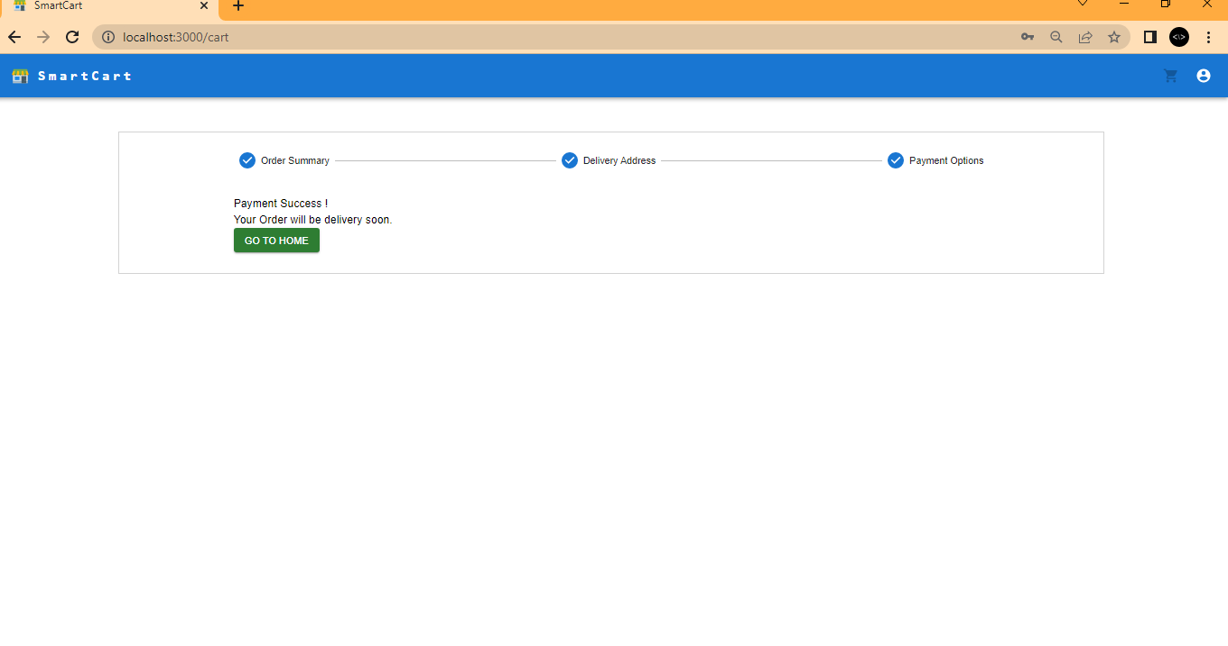

Slide 30
FURTURE ENHANCEMENT
E Mail Id and Mobile number registered in any real time server of the hacker are to be identified and their accounts are to be automatically deleted.
Location detection of IP address is achieved and automatically tracked.
Send a Pop up Notification for the user at the instance of hacking

Slide 31

CONCLUSION
In this project, we have to implement secured purchasing system in online.
Honey words are generated based on the user info provided and the original password is converted into another format and stored along with the Honey words.
If identify the hacker means , Hacker’s IP Address, E mail ID, Phone number and postal Address are tracked and stored.
Finally these details are sent to original user alternative mail id.

Slide 32
REFERENCE
[1] A. Sahai and B. Waters, “Fuzzy identity-based encryption,” in Eurocrypt, 2005, pp. 457–473.
[2] V. Goyal, O. Pandey, A. Sahai, and B. Waters, “Attribute-based encryption for fine-grained access control of encrypted data,” in ACM Conference on Computer and Communications Security, 2006, pp. 89–98.
[3] J. Bethencourt, A. Sahai, and B. Waters, “Ciphertext-policy attribute-based encryption,” in IEEE Symposium on Security and
Privacy, 2007, pp. 321–334.
[4] B. Waters, “Ciphertext-policy attribute-based encryption: An expressive, efficient, and provably secure realization,” in Public Key Cryptography, 2011, pp. 53–70.
[5] A. Sahai, H. Seyalioglu, and B. Waters, “Dynamic credentials and ciphertext delegation for attribute-based encryption,” in Crypto, 2012, pp. 199–217.
[6] S. Hohenberger and B. Waters, “Attribute-based encryption
with fast decryption,” in Public Key Cryptography, 2013, pp.
162–179.
[7] P. K. Tysowski and M. A. Hasan, “Hybrid attribute- and
reencryption- based key management for secure and scalable
mobile applications in clouds.” IEEE T. Cloud Computing, pp
. 172–186, 2013.
[8] Wired. (2014) Spam suspect uses google docs; fbi happy. [Online]. Available: http://www.wired.com/2010/04/cloud-warrant/
[9] Wikipedia. (2014) Global surveillance disclosures (2013present). [Online]. Available: http://en.wikipedia.org/wiki/Global surveillance disclosures (2013-present)
[10] ——. (2014) Edward snowden. [Online]. Available:
http://en. wikipedia.org/wiki/Edward Snowden

Slide 33
Thank You
For Your Attention

